Slide 1
Introduction to Computers and Programming
Colorado State University
Computer Science Department
Slides Originally Created by Albert Lionelle (Albert.Lionelle@colostate.edu)

Slide 2
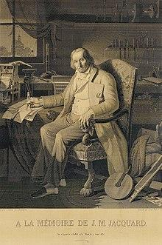
First Computer?
The industry - Weaving!
Jacquard loom / machine
Invented by Joseph Marie Jacquard in 1804
Cards set the patterns, colors, etc
Very specific use - not general purpose
We have come a long way over the years!!
“This portrait of Jacquard was woven in silk on a Jacquard loom and required 24,000 punched cards to create (1839). “ - ref: https://en.wikipedia.org/wiki/Jacquard_loom

Slide 3
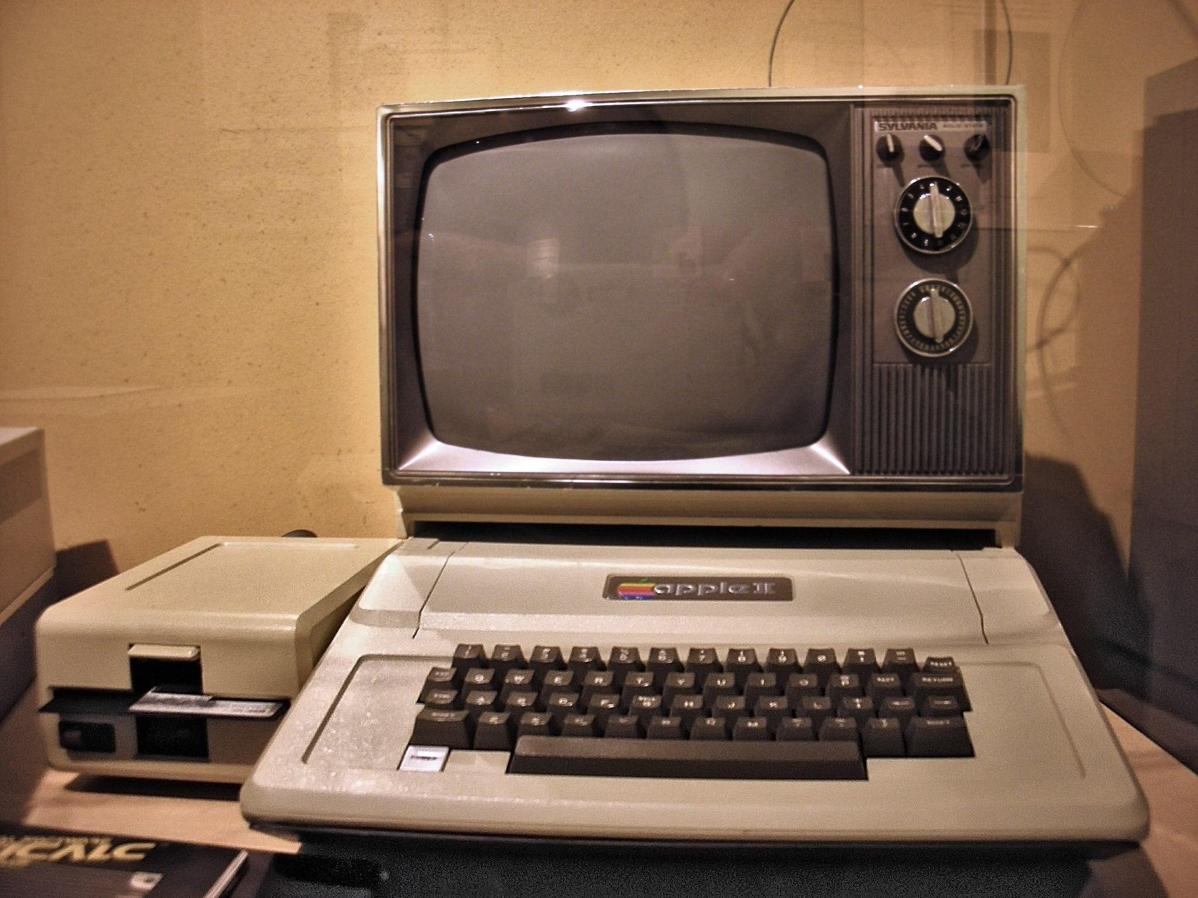
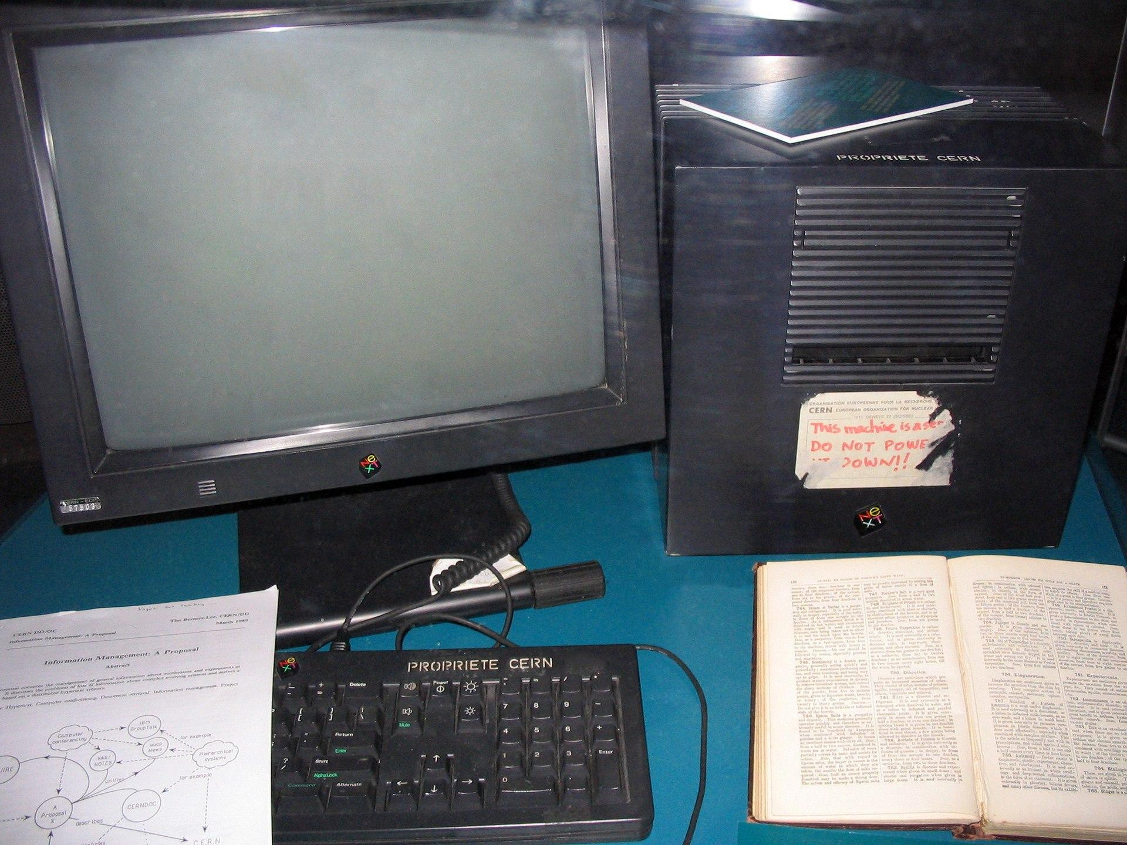
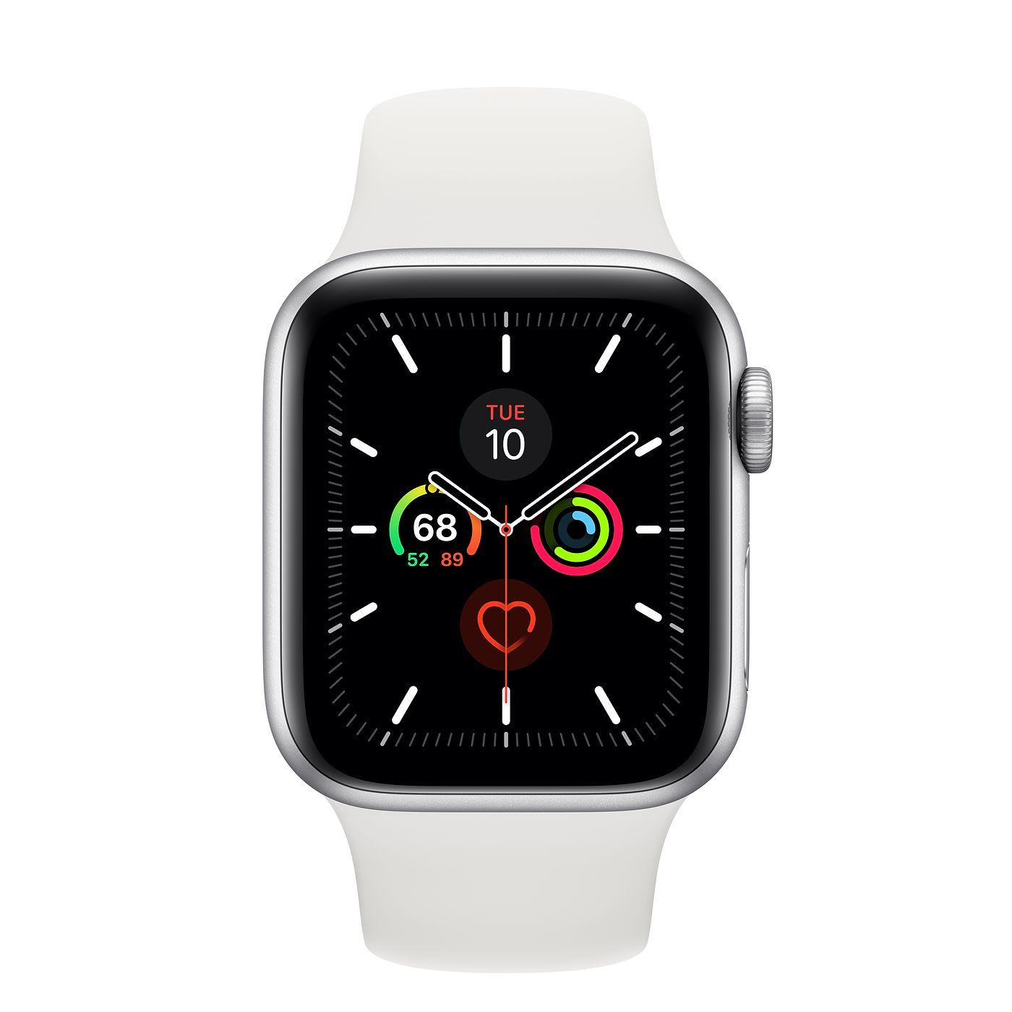
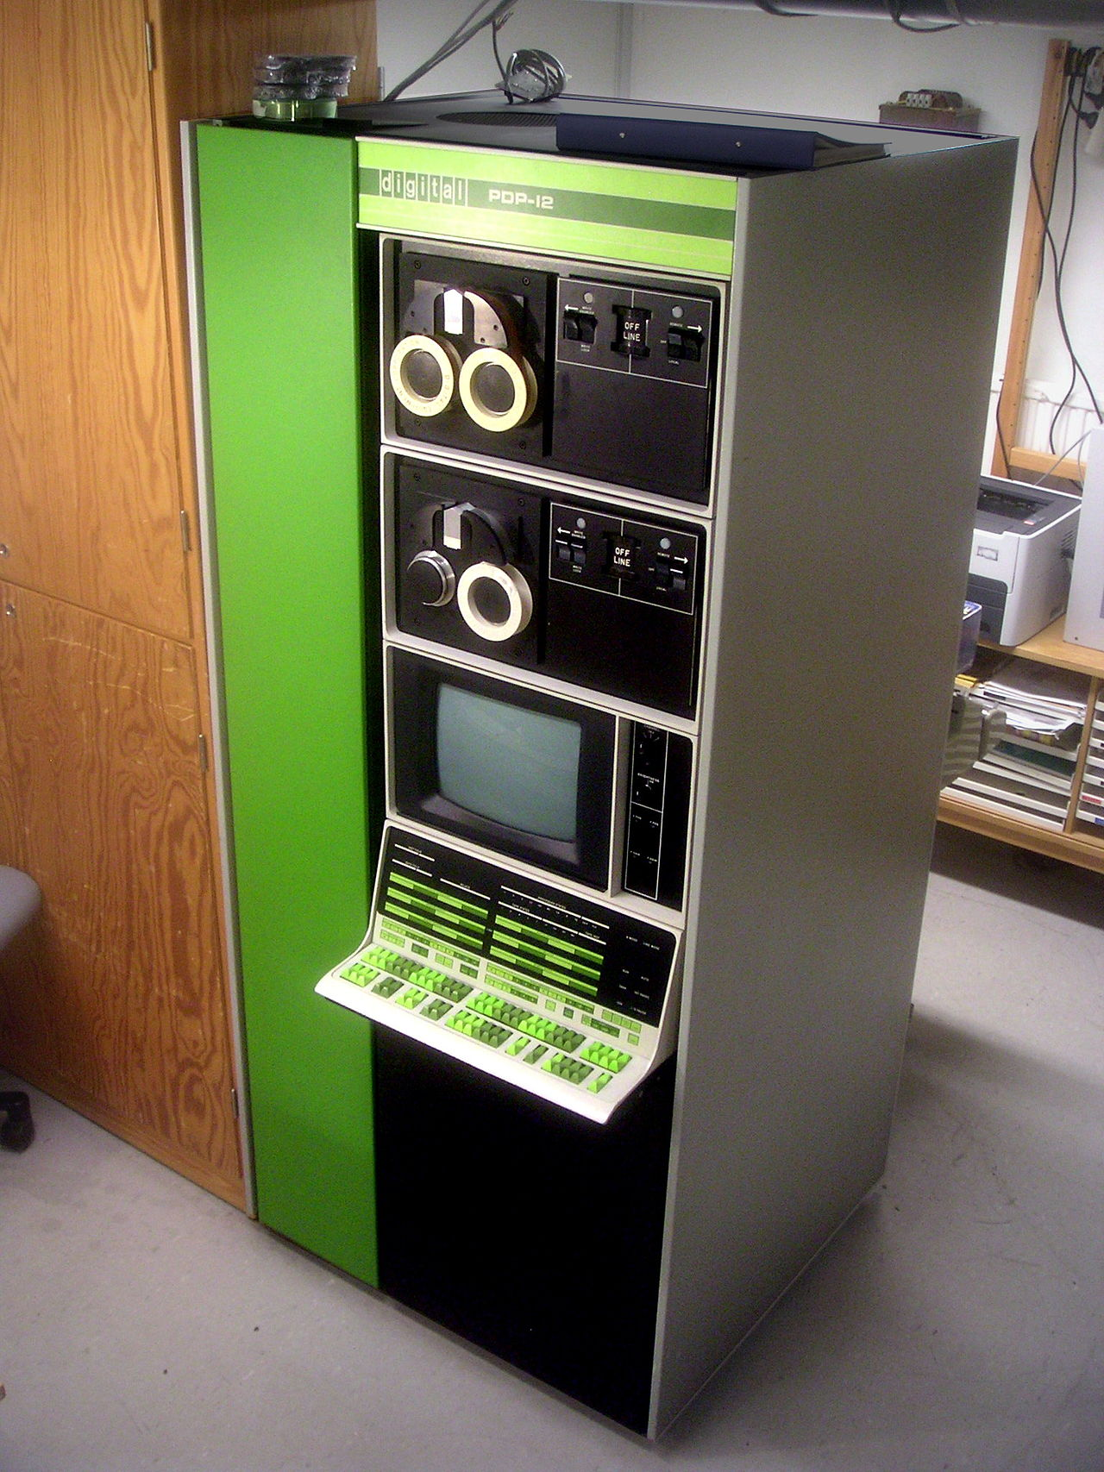
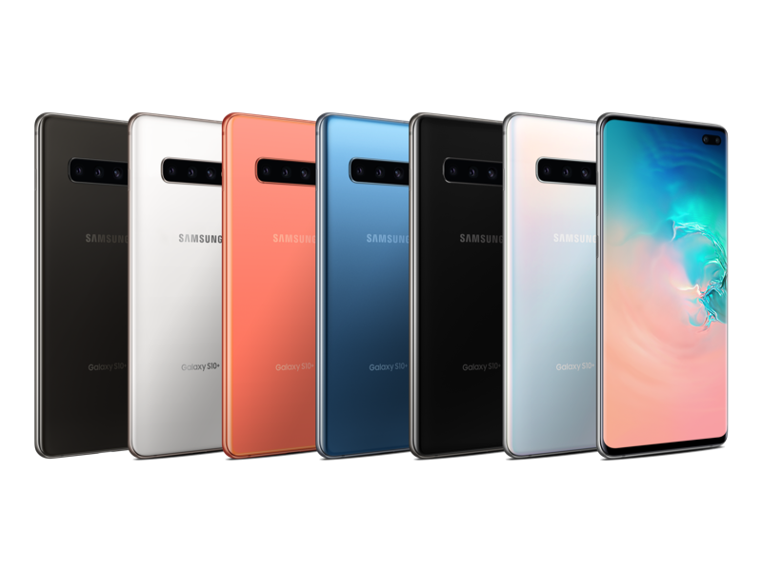
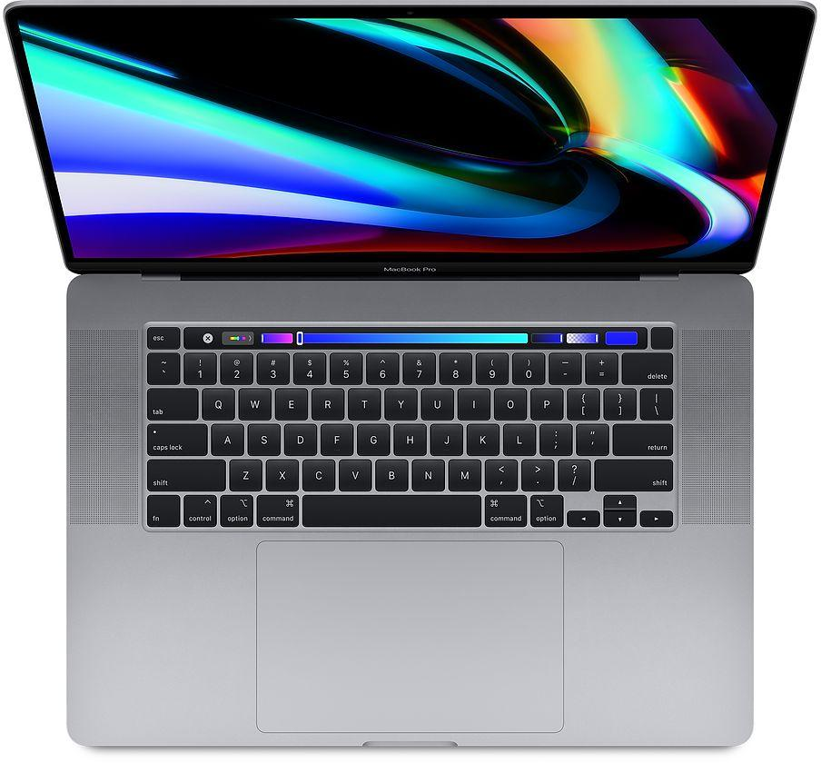
Computers
Come a long way!
Part of our everyday life
Phones, Watches, Laptops, more
None of it works without people!
Technology is a human activity
Computers work in concert with humanity, not seperate.
Think of a violin
Does it create music by itself?

Slide 4
Computers Hold STATE
Think of water states
Liquid, Ice, Gas - it is said to have multiple states.
Memory has two states (binary)
On and Off
Yes and No
true and false
1 and 0
This is stored in a BIT
All the representational power of the computer
A bunch of bits
Representing various states!

Slide 5
Bits and Numbers
We assign values based on location
First spot - even or odd
Second spot - 2
Third spot - 4
3 bits can represent 8 different things (0-7)
0
0
0
1
0
= 0
1
= 2
1
= 6
1
= 7
0
0
1
1
Note: Throughout Semester - we will write things in memory - but more of the style below
Would be painful to write it out / set it
All the time!
We want to write english words
Thus the power of programming
2
6
7

Slide 6
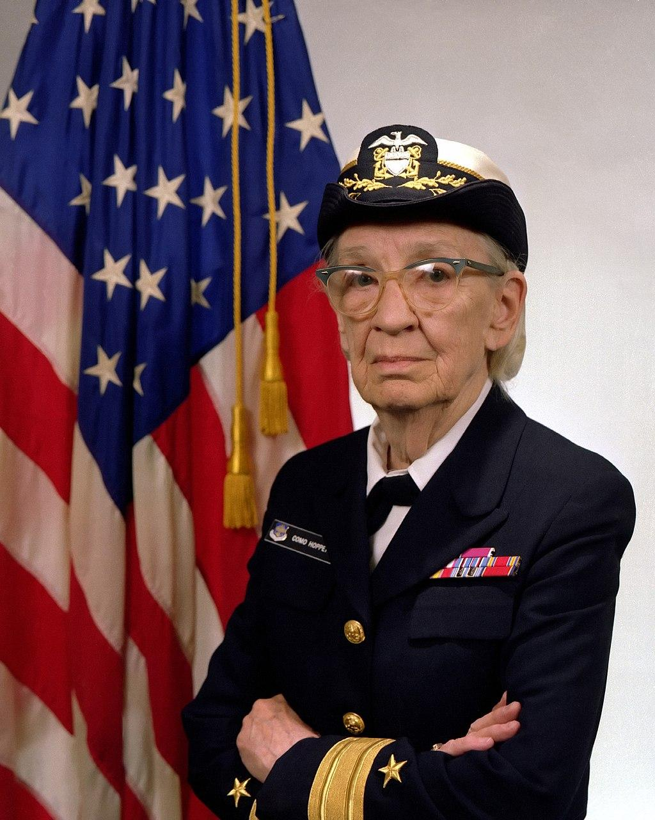
Coding
Coding used to be literally moving physical wires
And was unique to every machine
Then code became compiled
From English to 1s and 0s!
Who do we have to thank for compiled code?
Admiral Grace Murray Hopper
Designed the COBOL language
Her dream? Write once, run everywhere!
But it took many years for it to come to pass..
By James S. Davis [Public domain], via Wikimedia Commons. Source

Slide 7
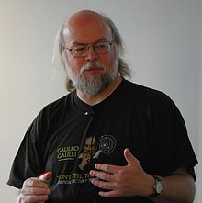
Java Bytecode
Hello.java
public class Hello {
public static void printHell() {
System.out.println(“Hello World”);
}
public static void(String args[]) {
printHello();
}
}
Write once - run most anywhere
James Gosling lead designer
Fun Fact
Android is the most used operating system in the world
Written in Java
Programs are a set of instructions
Written in English - very specific instructions
javac - compiler
0001100001010101010101010101001010101010101010100101010101010101010101010100101010101010101010100101010101010101010101010010101010101001001010001
Hello.class
James Gosling lead designer for the javac compiler
CC BY-SA 4.0 by Peter Campbell

Slide 8
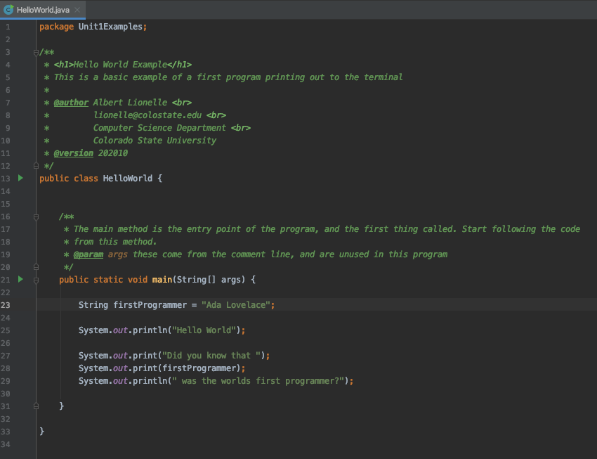
Program is a set of instructions
This is a comment
In java, instruction sets are written in class blocks
Method! - let’s look closer
Pro Tip: All examples in this class are available on github for you to download.

Slide 9
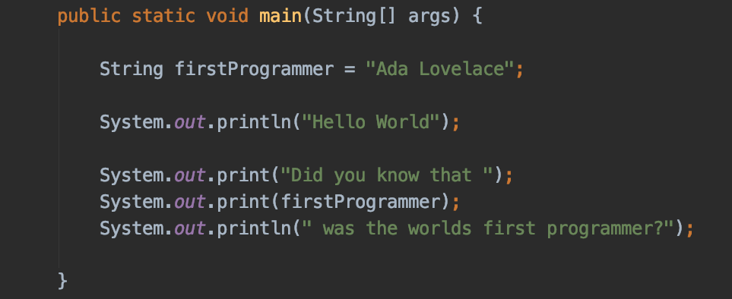

Method
Setting “Ada Lovelace” to the variable firstProgrammer
Printing out to the console/terminal

